Slide 1
MLMH
2018
Forecasting Disease Trajectories in Alzheimer’s Disease Using Deep Learning
Bryan Lim & Mihaela van der Schaar
University of Oxford
Jointly forecasting multiple clinical outcomes for chronic diseases
Multitask deep neural network with uncertainty estimates
Improving outcome predictions (survival/longitudinal) at different horizons

Slide 2
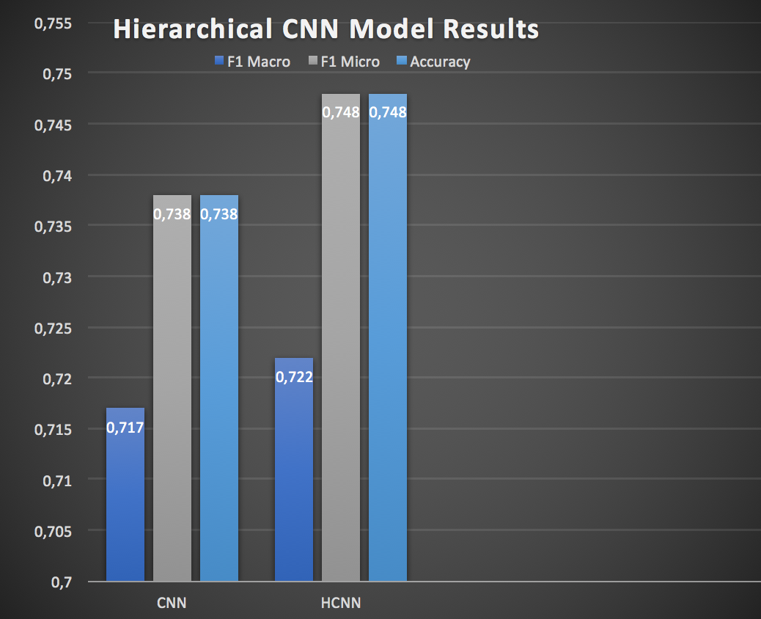
MLMH
2018
Hierarchical Deep Learning Framework to Automate the Classification of Breast Cancer Pathology Reports by ICD-O Topography
Waheeda Saib
IBM Research Africa
Problem statement :
Reduce cancer reporting lag by automating pathology report labelling
Novelty :
Exploit ICD-O hierarchical structure to
create Hierarchical Deep Learning Ensemble
Result:
Improves on flat multiclass benchmarks for ICD-O topography classification

Slide 3
MLMH
2018
Mammography Dual-View Mass Correspondence
Shaked Perek
Dual-View Mass matching for better tumor detection
Patch-based Siamese network for mammography mass matching
A learned distance metric implemented in the network and its value to a single view detection.

Slide 4
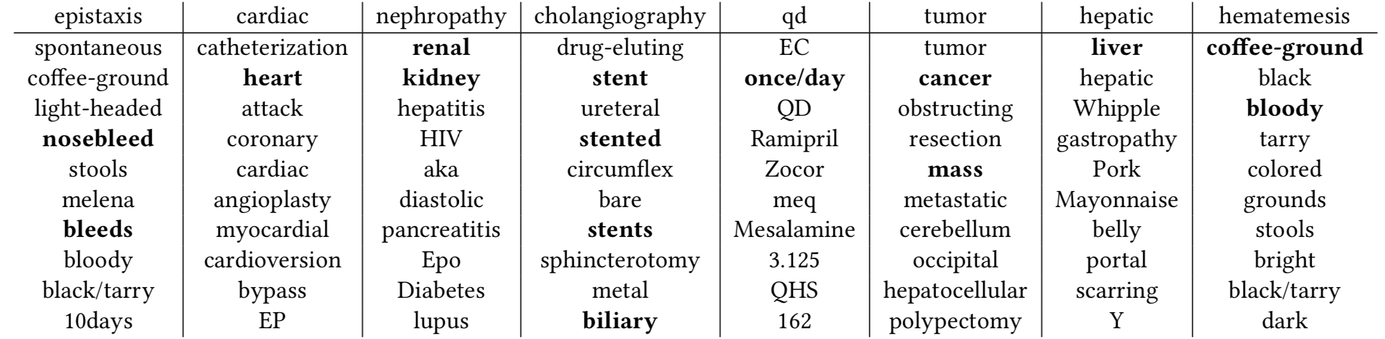
MLMH
2018
Mapping Unparalleled Clinical Professional and Consumer Languages with Embedding Alignment
Wei-Hung Weng (MIT)
Professional clinical language hinders patient-clinician communication
Mapping professional to layman’s language with embedding alignment

Slide 5
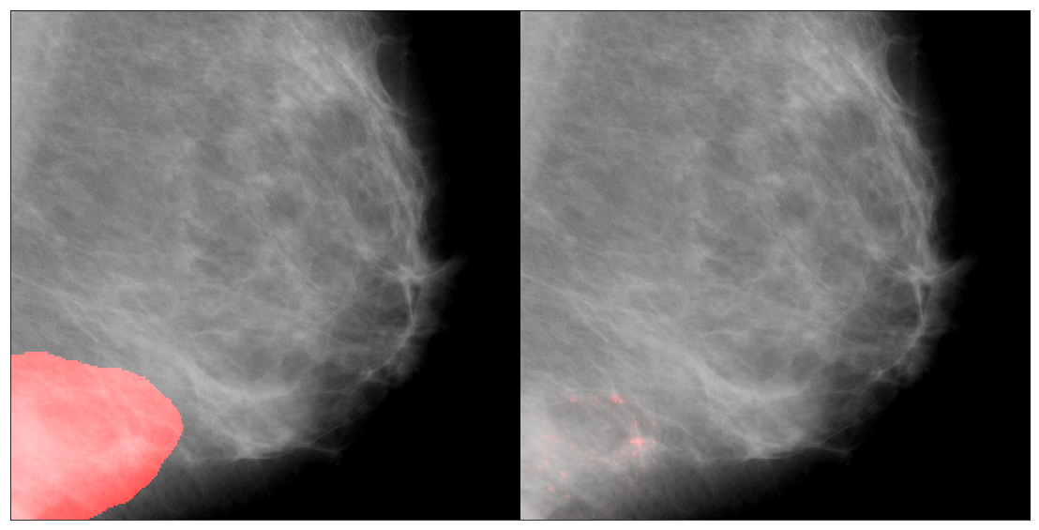
MLMH
2018
Mammography Assessment using Multi-Scale Deep Classifiers
Ulzee An, Courant Institute of Mathematical Sciences, New York University
Email: ua349@nyu.edu
Problem
Results
Small details are missed when subsampling x-ray Mammography
High accuracy tissue classifiers indicate exact cancerous pixels
Novelty
Local tissue classifiers and context encoder identify suspicious regions

Slide 6
MLMH
2018
Recognising Cardiac Abnormalities in Wearable Device Photoplethysmography (PPG) with Deep Learning
Stewart Whiting et al. (snap40)
Reliably spotting risky cardiac abnormalities with conventional wearable sensors
Novel DL application and large-scale clinical data evaluation
60-70% of ECG-detected cardiac anomalies spotted in wearable bloodflow (PPG) data

Slide 7
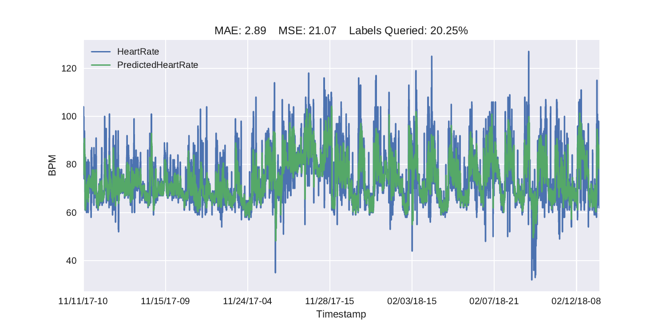

MLMH
2018
Online Heart Rate Prediction using Acceleration from a Wrist Worn Wearable
Ryan McConville (University of Bristol)
PPG is energy-hungry – Accelerometers are energy efficient
Online AL algoritm predicting heart-rate to high accuracy

Slide 8
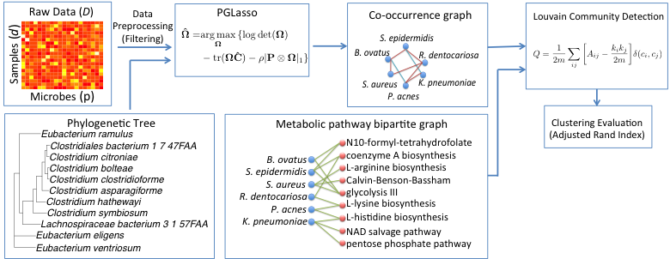
MLMH
2018
PGLasso: Microbial Community Detection through Phylogenetic Graphical Lasso
Chieh Lo
Carnegie Mellon University
Understand how microbes form functional communities that relate to certain diseases
Utilize phylogenetic information to leverage the problem of high dimensionality paper
Main result:

Slide 9
MLMH
2018
Generating Synthetic but Plausible Healthcare Record Datasets
Laura Aviñó*+, Matteo Ruffini* and Ricard Gavaldà†.
+Esci-UPF Barcelona, Spain; * UPC Barcelona, Spain; †BGSMath, Barcelona, Spain
Generation of synthetic Data that looks like real.
A fast and simple to tune new method
Random Forest performs under 55% classifying synthetic data

Slide 10
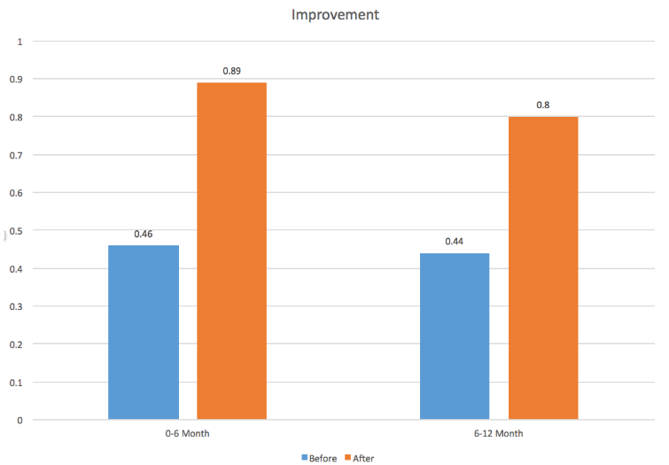
MLMH
2018
Predicting Infant Motor Development Status Using Day Long Movement Data from Wearable Sensors
David Goodfellow
Student at the University of Southern California
Can inertial movement data be used to classify infant development status?
Establishes further the relationship between kinematic features and infant development.

Slide 11
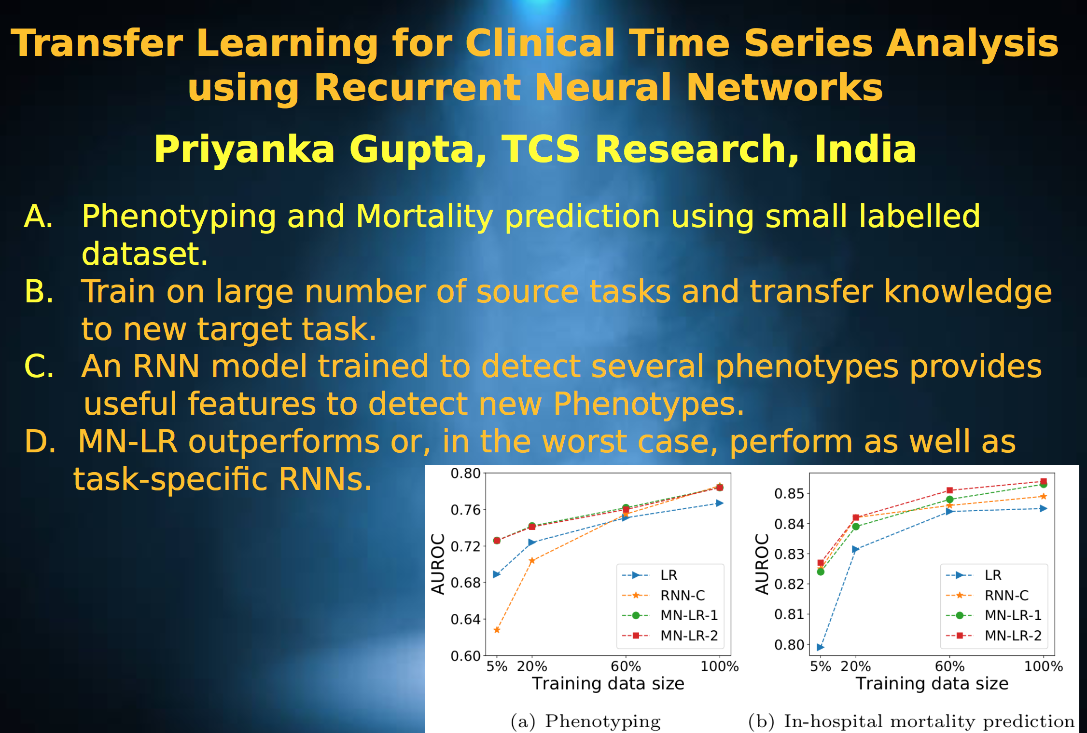
MLMH
2018

Slide 12

MLMH
2018
From Text to Topics in Healthcare Records:
An Unsupervised Graph Partitioning Methodology
M. Tarik Altuncu
Problem: Unstructured free text remains under-used in Electronic Healthcare Records
Solution: An unsupervised network-theoretical method merged with text embedding for multi-scale content clusters
Notes:
Electronic Healthcare Records remain under-used because of a lack of methodologies to extract interpretable content from large volumes of unstructured data, including free text.
Our solution is to apply network-theoretical tools to find clusters of documents with similar content in an unsupervised manner at different levels of resolution.
Our results show almost hierarchical structure in clusters as seen on the bottom left diagram. Results are coherent with handcoded labels, but provide more details on finer resolutions.

Slide 13
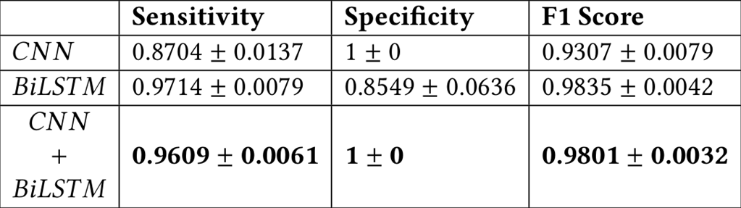
MLMH
2018
Murmur Detection Using Parallel Recurrent & Convolutional Neural Networks
Shahnawaz Alam
Researcher, Tata Consultancy Services
Problem- Automatic Heart Sound Murmur Detection
Novelty- Parallel DNN to identify time and frequency level markers.
Results (5 folds)

Slide 14
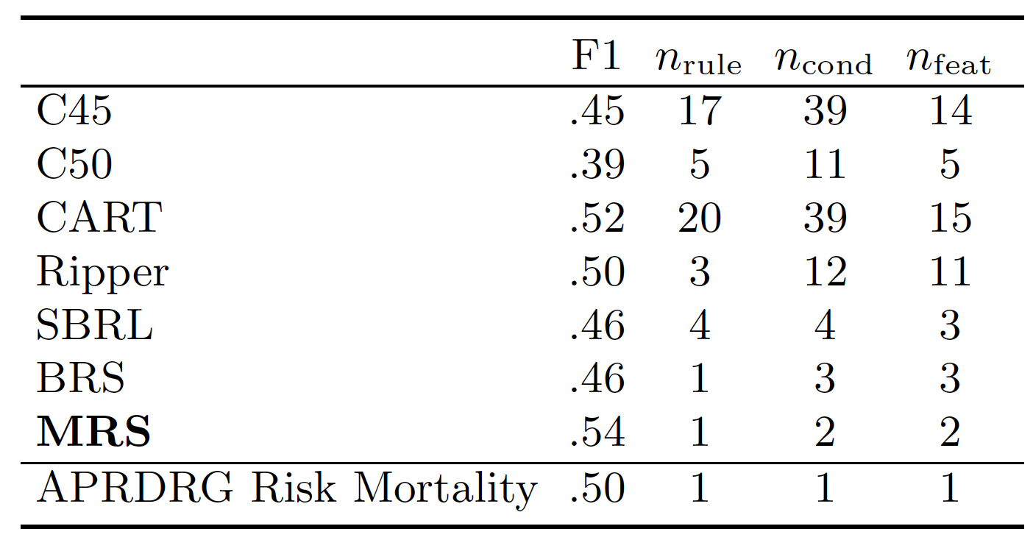
MLMH
2018
Interpretable Patient Mortality Prediction with Multi-value Rule Sets
Tong Wang¹, Veerajalandhar Allareddy¹, Sankeerth Rampa², Veerasathpurush Allareddy³
¹ University of Iowa
²Rhode Island College
³University of Illinois at Chicago
An interpretable rule-based model for predicting in-hospital mortality
Multi-value rules for concise and feature-efficient presentation
Main result:

Slide 15
MLMH
2018
A hybrid deep learning approach for medical relation extraction
-Veera Raghavendra Chikka, IIITH, India
Mining relationships between treatment and problem from EHRs.
Using deep learning (Bi-LSTM) and rule-based approaches.
Rule-based system with high-precision leverages the performance of the neural network on I2b2 relation extraction task.

Slide 16
MLMH
2018
PIVETed-Granite: Computational Phenotypes through Constrained Clustering
Jette Henderson, UT Austin
Unsupervised phenotyping methods can result in noisy phenotypes
Guidance process uses insights from 1M+ PubMed articles
Guidance results in discriminative and diverse phenotypes

Slide 17
MLMH
2018
Ensemble learning with Conformal Predictors:
Targeting confident predictions of conversion from Mild Cognitive Impairment to Alzheimer's Disease
Telma Pereira
University of Lisbon, Portugal
To assess uncertainty of individual predictions
Ensemble learning combining credible conformal predictors
Improved performance at high credibility thresholds but low efficiency

Slide 18
MLMH
2018
YouTube for Patient Education: A Deep Learning Approach for Understanding Medical Knowledge from User-Generated Videos
Xiao Liu¹, Bin Zhang², Anjana Susarla³, Rema Padman⁴
1: Univ. of Utah, 2: Univ. of Arizona, 3: Michigan State Univ., 4:Carnegie Mellon Univ.
Classify diabetes YouTube videos for patient education and improving health literacy
Novelty of the deep learning application and the promising preliminary results
Performance (F-Measure):
Text-based knowledge extraction: 93%
Logistic regression classification: 85%

Slide 19
MLMH
2018
Multi-Task Learning with Incomplete Data for Healthcare
Xin Jiang Hunt, SAS Institute Inc.
Problem Statement: Missing data in healthcare records cause inaccurate inference
Novelty: Use plug-in covariance estimators in multi-task learning
Main result: Plug-in covariance estimators achieves better prediction than single-imputation

Slide 20
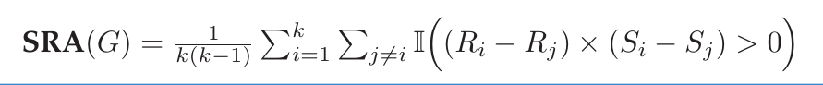
MLMH
2018
Measuring the quality of Synthetic data for use in competitions
James Jordon, University of Oxford
Problem: Measure the quality of synthetic data
Novelty: New perspective on what is important
Main result: Synthetic Ranking Agreement

